Slide 1
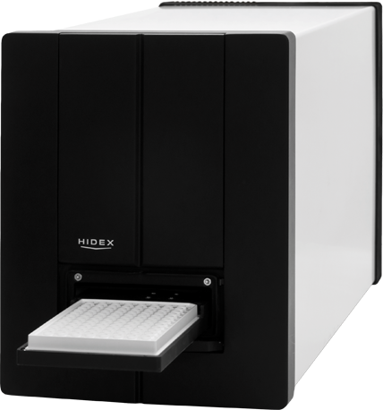
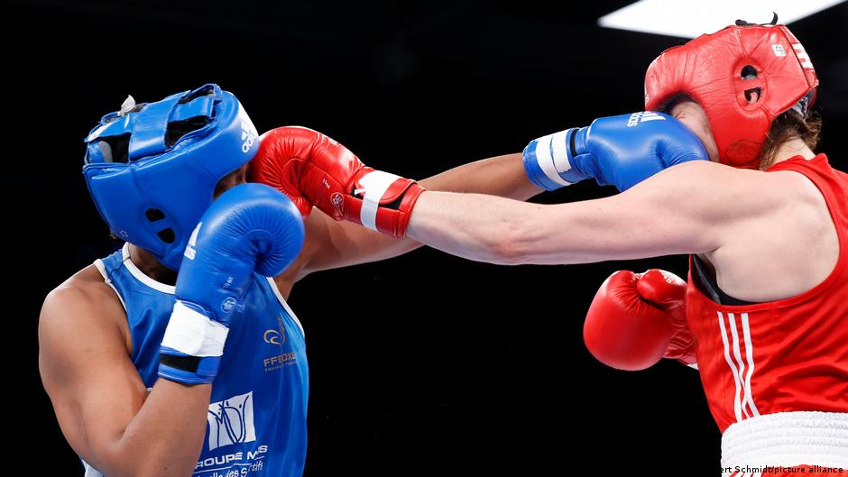
6/29/2023 Updates:
Journal Club Presentation Went Well!
Learned C# Scripts, Sockets, and Hidex Client
Me vs. Hidex (Round by Round) Round One
Hidex: Overwhelmed by pinging
Response: Global action in process boolean and global static client with defined address
Round Two
Hidex: Stuck on accept state in socket and abandoned mutex error
Response: Created TCPlistener class
Round Three
Hidex: Forcibly closed by host error
Response: Polled before receiving data to assess if RST packet is being sent
Future Goals:
Get the Hidex client running in a 12 hour “REAL CELLS TEST” without problems
Begin to create infrastructure to house AI-based runs (“Barcoding” plates, reading stock Solo columns from experiment level to the workflow )
Alp Demirtas

